Slide 1
Weekly update 7.2
Paper :
Taking a Peek: An Evaluation of Anomaly Detection Using System calls for Containers

Slide 2
Summary
Their work aims to use system calls to identify threats within a container environment, using machine learning based strategies to distinguish between expected and unexpected behaviors (possible threats)
The semantic gap between the virtual environment and the host is very small in containers, in comparison to traditional virtual machines. This allows an external observer to gather very detailed information about the applications running inside a container.

Slide 3
pRopOSAL
Monitoring vulnerabilities at the application level is a processor-consuming task, and it is impracticable to carry out a monitoring from inside the container due to its restrictions and limited resources, as well as the risk of having the IDS exposed to the attacker.
An option would be to monitor the guest processes from the host system.

Slide 4
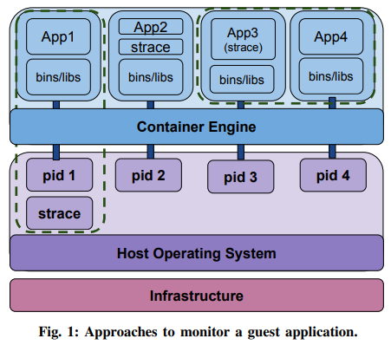
3 approaches to collect syscall info from guest processes

Slide 5
Strategy-1
Run the IDS at the host level, outside the container
This protects the IDS against a compromised container
Represented by App1 in Fig. 1

Slide 6
Strategy-2
Using the trace application inside the same container the application is running
May be harmful to the IDS
Represented by App2 in Fig. 1

Slide 7
Strategy-3
Privileged container for running the IDS
The IDS container should have access rights to the processes being monitored, to gather the system calls they issue
It allows to define a complete IDS container, that can be easily deployed elsewhere

Slide 8
Data collection
The strace tool is used to collect all the interactions between the guest process and the kernel
Enough information was collected to build a base of normal behaviors
Containing sequences of system calls that represent the normal functioning of the app
Sequences that represent it under an attack or malicious behavior, to evaluate the proposal

Slide 9
Evaluation
The application selected for the tests was Wordpress, a web application that runs over the Apache web server
The dataset built contains fifty traces
Half from normal behavior that consist of expected interactions with the app
Other half from anomalous behavior consisting of attacks
Two groups of tests were developed
Without filtering
Least dangerous syscalls were discarded (filtered)
Notes:
The extensive use of third-party plugins and personalized themes opens the door to security flaws involving Cross-site scripting (XSS), SQL injection, Remote Code Execution (RCE), among others.

Slide 10
Algorithms used
K-Nearest Neighbors (KNN) with a k = 3
Random Forest (RF)
Multilayer Perceptron (MLP)
AdaBoost (AB)

Slide 11
accuracy
The efficiency of each algorithm was evaluated using four metrics:
Precision
Recall
f1-score
accuracy

Slide 12
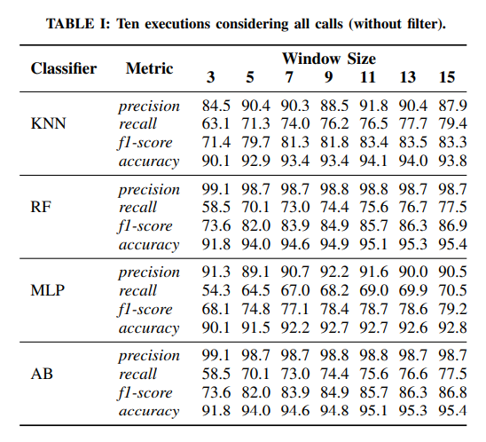

Slide 13
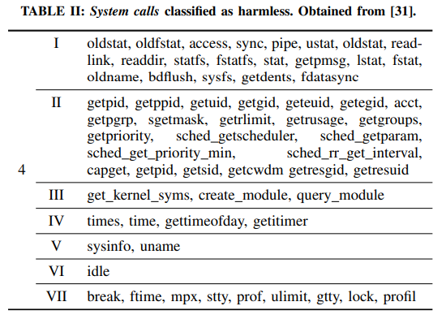
Discarded syscalls

Slide 14
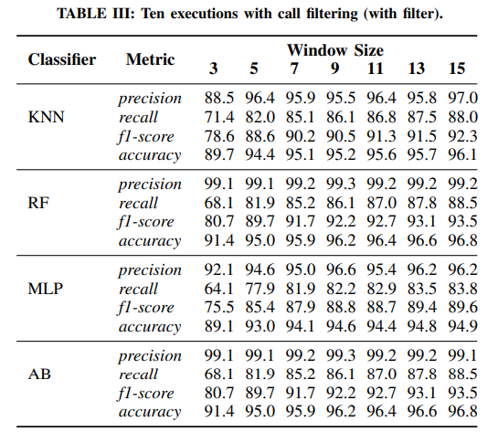

Slide 15
results
The classifiers that presented the best performance were Random Forest and AdaBoost

Slide 16
Dataset and code
https://github.com/gabrielruschel/hids-docker

